Slide 1
Normalization Exercise

Slide 2
Exercise 1
A
B
C
D
E
F
G

Slide 3
Exercise 2
Member Cod | Skill Code | Skill Type | Title | Name | Last Name | Age | Group Code | City Code | Post Code

Slide 4
EXERCISE 3: Analyze and prepare Normalization Expert database system To have the least redundancy.
Expert Code | Expertise Code | The Expertise | Name | Last Name | Department Code | Department Name | Location
21 | 113 | System | Alice | Adams | 55 | Brown | NYC
35 | 113 | System | Tom | Hank | 32 | Green | LA
 | 179 | Database
 | 204 | Program
50 | 179 | Database | Robert | Cody | 40 | Yellow | Mexico
77 | 148 | Web | Lisa | Baker | 52 | Black | Hawaii
 | 179 | Database

Slide 5
EXERCISE 4: Analyze and prepare Normalization Student registration system To have the least redundancy.
Code | Term | Subject Code | Subject Name | Subject Category | Category Name | Credit Hours | Grade
4501 | 1/45 | A01 | Mathematics | 02 | Natural Science | 3 | F
 | 1/45 | A03 | Urdu Language | 01 | Basic Studies | 3 | C
 | 2/45 | A01 | Mathematics | 02 | Natural Science | 3 | D
 | 2/45 | A04 | English 1 | 01 | Basic Studies | 3 | D+
4502 | 1/45 | A01 | Mathematics | 02 | Natural Science | 3 | B
 | 1/45 | A04 | English 1 | 01 | Basic Studies | 3 | C
 | 2/45 | A02 | Database System | 03 | Computer Science | 3 | B
 | 2/45 | A05 | Physics | 02 | Natural Science | 3 | D
4503 | 1/45 | A06 | Data communication | 03 | Computer Science | 3 | A
 | 1/45 | A04 | English 1 | 01 | Basic Studies | 3 | C
 | 2/45 | A05 | Physics | 02 | Natural Science | 3 | D
4506 | 1/45 | A03 | Urdu Language | 01 | Basic Studies | 3 | B+
 | 1/45 | A04 | English 1 | 01 | Basic Studies | 3 | C

Slide 6
Exercise 5
Stereos To Go
Invoice
Order No.
10001
Date:
06/15/2010
Account No.
0000-000-0000-0
Customer:
John Smith
Address:
2036-26 Street
Sacramento CA 95819
City
State
Zip Code
Date Shipped:
06/15/2010
Item
Product
Number
Code
Product Description/Manufacturer
Qty
Price
1
SAGX730 Pioneer Remote A/V Receiver
1
1
1
56995
35995
39995
2
AT10 Cervwin Vega Loudspeakers
3
CDPC725 Sony Disc-Jockey CD Changer
4
5
Subtotal
Shipping & Handling
Sales Tax
Total
132985
10000
10306
153291

Slide 7
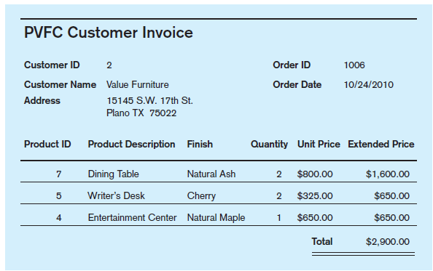
Exercise 6

Slide 8
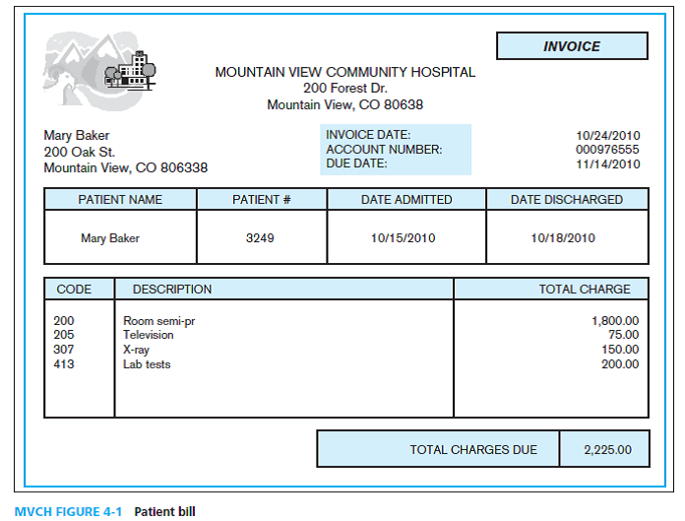
Exercise 7

Slide 9
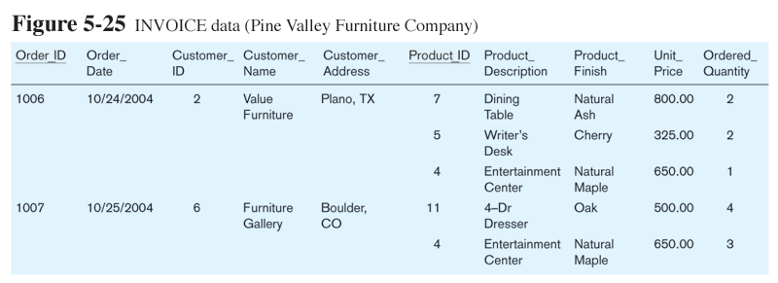

Slide 10
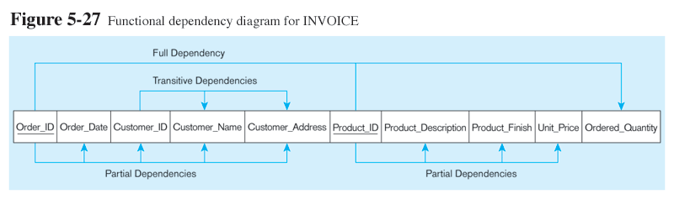
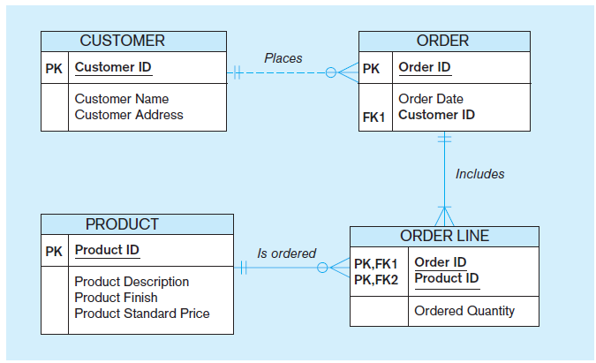

Slide 11
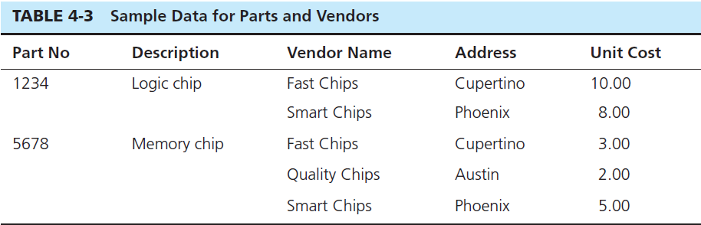
Exercise 1
Table 4-3 contains sample data for parts and for vendors who supply those parts. In discussing these data with users, we find that part numbers (but not descriptions) uniquely identify parts and that vendor names uniquely identify vendors.
Convert this table to a relation (named PART SUPPLIER) in first normal form. Illustrate the relation with the sample data in the table.
List the functional dependencies in PART SUPPLIER relation and identify a candidate key.
Develop a set of 3NF relations from PART SUPPLIER.

Slide 12
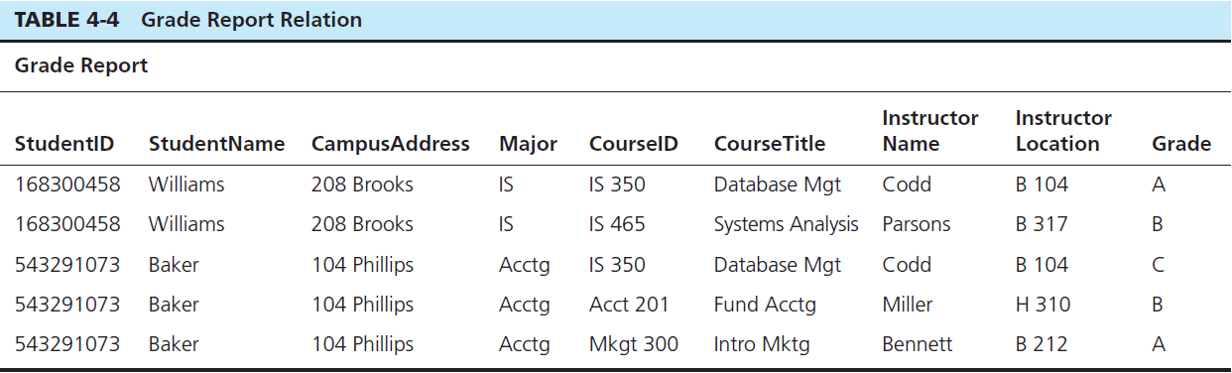
Exercise 2
Table 4-4 shows a relation called GRADE REPORT for a university.
In what normal form is this relation?
Decompose GRADE REPORT into a set of 3NF relations.

Slide 13
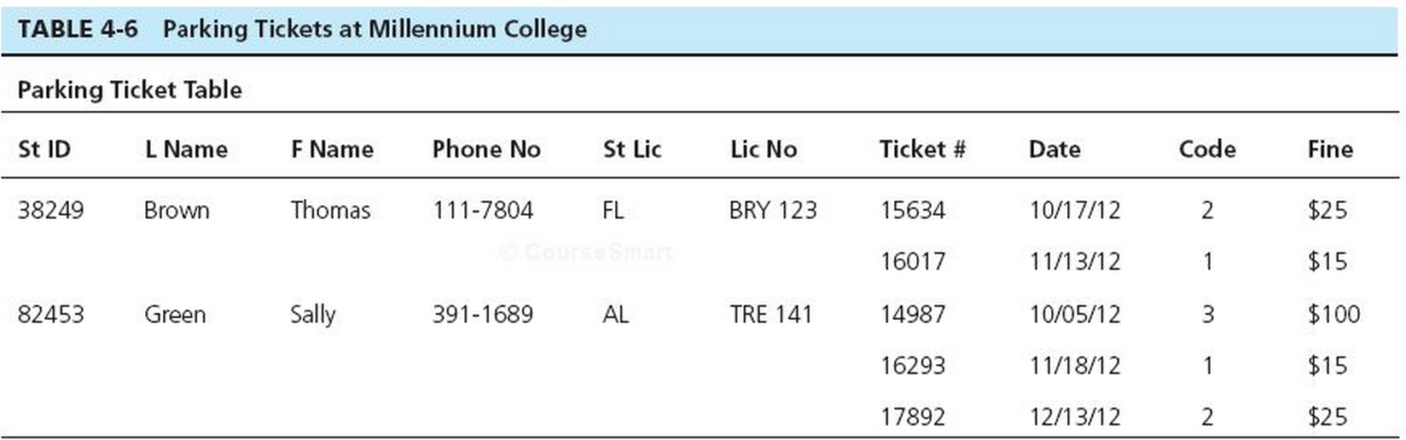

Slide 14
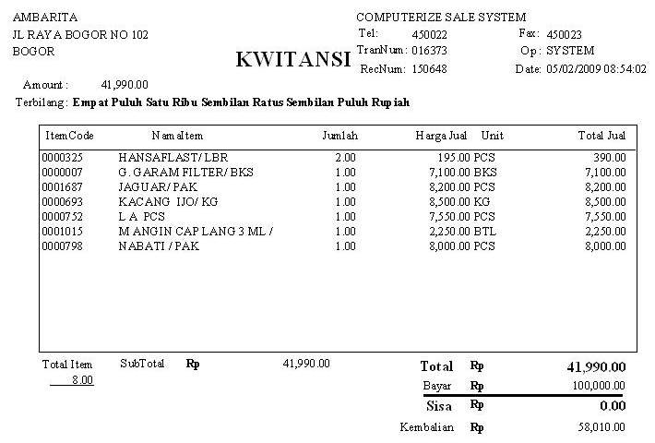

Slide 15
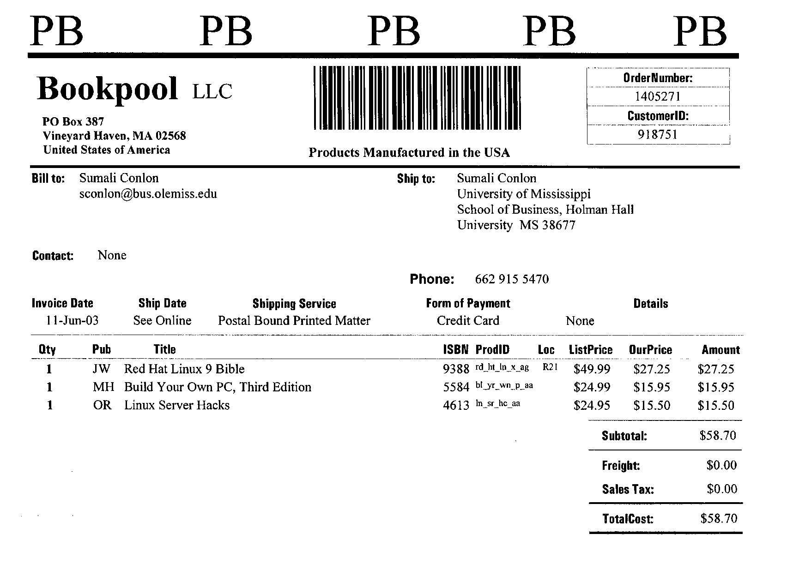

Slide 16
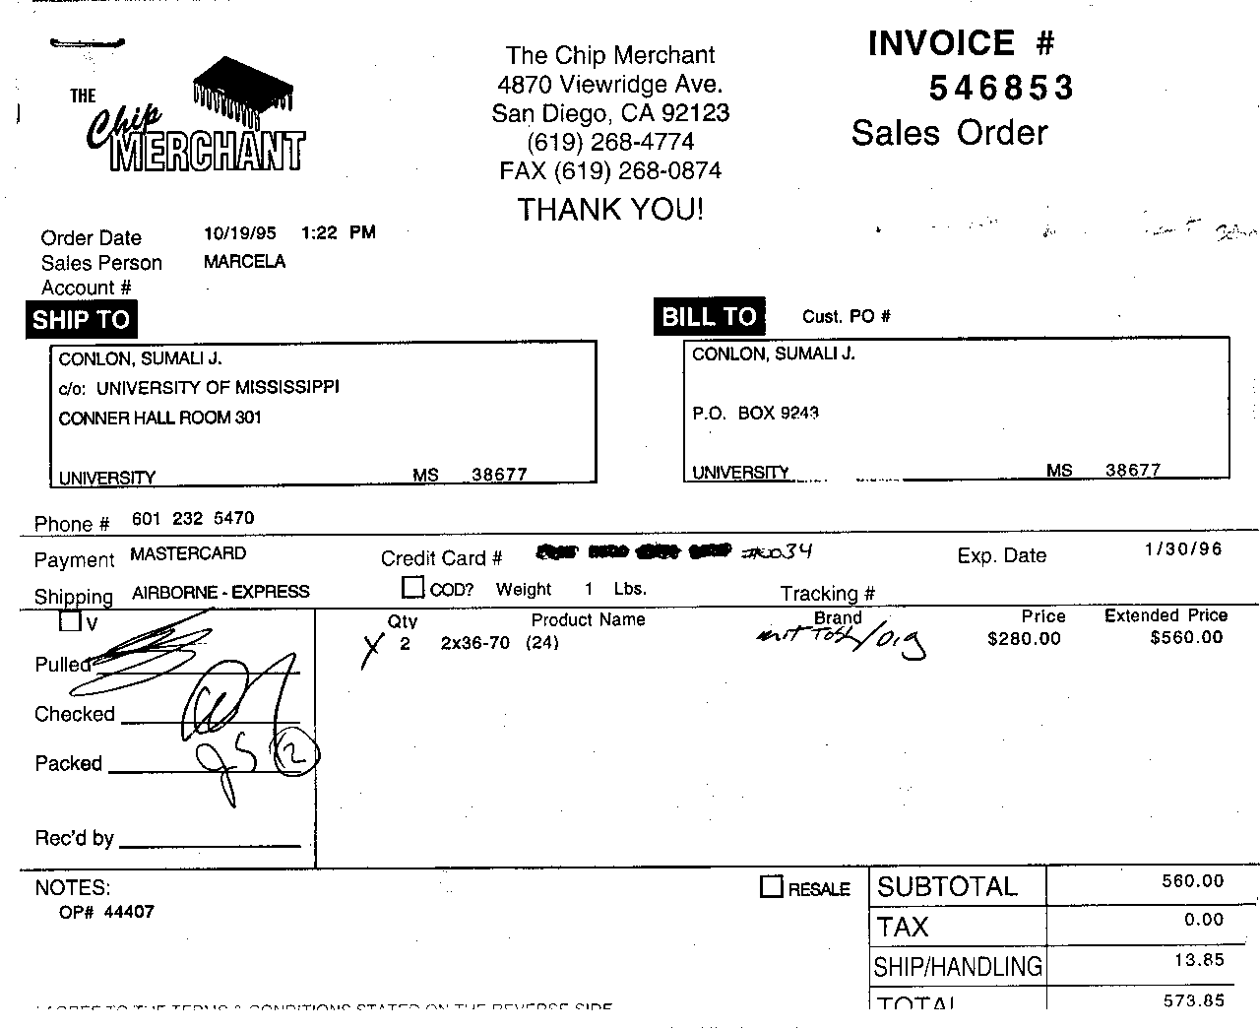

Slide 17
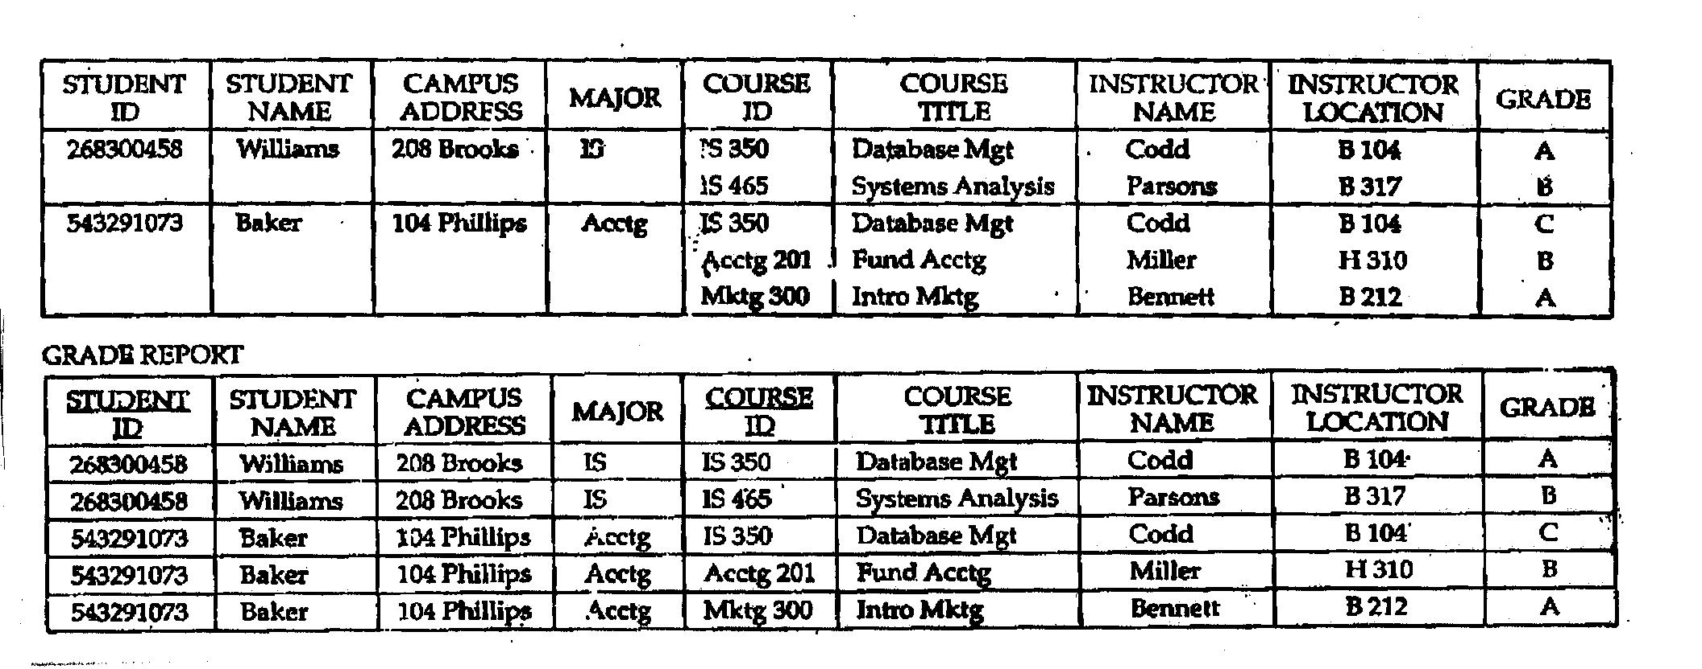

Slide 18
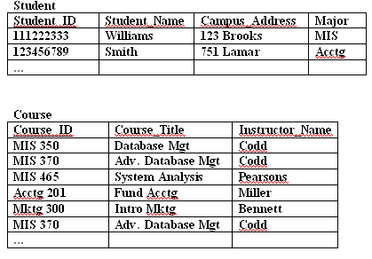
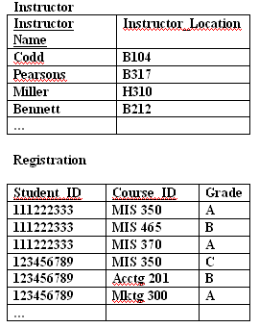
University Database
(Third Normal Form relations)

